Slide 1

PRESENTATION
ON
HADOOP INSTALLATION
Submitted By:
Sonali Gupta

Slide 2
CONTENTS
Introduction
Pre-requisites
Installation
Configuration
Execution
Word count example

Slide 3
INTRODUCTION
Hadoop was created by Doug Cutting, the creator of Apache Lucene, a widely used text search library.
Hadoop is a generic processing framework designed to execute queries and other batch read operations on massive datasets that can scale from tens of terabytes to petabytes in size.
HDFS and MapReduce together provide a reliable, fault-tolerant softwareframeworkforprocessingvastamountsofdatainparallelonlargeclusters of commodity hardware .
Now the later section describes how to set up and configure a single-node Hadoop installation so that you can quickly perform simple operations using Hadoop MapReduce and the Hadoop Distributed File System (HDFS).

Slide 4
PREREQUISITES
SUPPORTED PLATFORM : Linux is supported as a development and production platform.
REQUIRED SOFTWARE : Required software for Linux include:
Java 8 JDK : Hadoop 3.0 requires a working Java 8
ssh must be installed and sshd must be running to use the Hadoop scripts that manage remote Hadoop daemons
INSTALLING JAVA 8
Update the source list:-
sudo apt-add-repository ppa:webupd8team/java
sudo apt-get update
sudo apt-get install oracle-java8-installer
The full JDK which will be placed in /usr/lib/jvm/java-8-oracle After installation, check whether java JDK is correctly installed or not, with the following command
java -version

Slide 5
Contd..
CONFIGURING SSH: The hadoop control scripts rely on SSH to perform cluster-wide operations. For example, there is a script for stopping and starting all the daemons in the clusters. To work seamlessly, SSH needs to be setup to allow password-less login for the hadoop user from machines in the cluster.
If your cluster doesn’t have the requisite software you will need to install it.
For example on Ubuntu:
$ sudo apt-get install ssh
Run $ ssh localhost to check the working of localhost
If you cannot ssh to localhost , execute the following commands:
$ ssh-keygen -t rsa -P '' -f ~/.ssh/id_rsa
$ cat ~/.ssh/id_rsa.pub >> ~/.ssh/authorized_keys
$ chmod 0600 ~/.ssh/authorized_keys

Slide 6
Hadoop Installation
To get a Hadoop distribution, download Apache Hadoop 3.0 (i.e. hadoop-3.0.0.tar.gz) a recent stable release from one of the Apache Download Mirrors:
http://www.apache.org/dyn/closer.cgi/hadoop/common/hadoop-3.0.0/hadoop-3.0.0.tar.gz
Choose location where you want to place all your hadoop installation, I have chosen /home/geu/Hadoop {NOTE:- this is the full path from root}
Extract Hadoop source -
$ sudo tar -xzvf /{location of Hadoop folder}/hadoop-3.0.0.tar.gz
e.g:- sudo tar –xzvf /home/geu/Downloads/hadoop-3.0.0.tar.gz
Pseudo-Distributed Operation
Hadoop can be run on a single-node in a pseudo-distributed mode where each Hadoop daemon runs in a separate Java process.

Slide 7
Contd…
Setup Environment Variables for Hadoop .
Open .bashrc ﬁle by using command
$ gedit .bashrc
Set Hadoop-related environment variables
export HADOOP_HOME=/usr/geu/hadoop
Add bin and sbin directory of hadoop to PATH
export PATH= $PATH:$HADOOP_HOME/bin
export PATH= $PATH:$HADOOP_HOME/sbin
After that run the command to compile the bashrc file.
$ source .bashrc
Now set up the environment variables in hadoop-env.sh file
Edit the ﬁle: HADOOP/etc/hadoop/hadoop-env.sh
export JAVA_HOME=/usr/lib/jvm/java-8-oracle

Slide 8
CONFIGURATION
“make a directory data in hadoop, under data create two directory namenode and datanode”
Use the following and edit the four configuration files in Hadoop folder:
etc/hadoop/core-site.xml
<property>
<name>fs.defaultFS</name>
<value > hdfs://localhost:9000</value>
<description>The name of the default file system </description>
</property>

Slide 9
contd…
etc/hadoop/hdfs-site.xml:
<property><name>dfs.replication</name>
<value>1</value>
</property >
<property><name> dfs.namenode.name.dir </name>
<value> /home/geu/HADOOP/data/namenode </value>
</property >
<property><name> dfs.datanode.name.dir </name>
<value> /home/geu/HADOOP/data/datanode </value></property >

Slide 10
Contd…
etc/hadoop/mapred-site.xml:
<property>
<name> yarn.app.mapreduce.am.env </name>
<value> HADOOP_MAPRED_HOME=$HADOOP_HOME </value>
</property>
<property>
<name> mapreduce.map.env </name>
<value> HADOOP_MAPRED_HOME=$HADOOP_HOME </value>
</property>
<property>
<name> mapreduce.reduce.env </name>
<value> HADOOP_MAPRED_HOME=$HADOOP_HOME </value>
</property>
<property>
<name>mapreduce.framework.name</name>
<value>yarn</value>
</property>

Slide 11
Contd…
etc/hadoop/yarn-site.xml:
<property>
<name> yarn.nodemanager.aux-services </name>
<value> mapreduce_Shuffle </value>
</property >

Slide 12
EXECUTION
Format the filesystem (one time):
$ hdfs namenode –format
Starting the single node cluster
$ start-all.sh
Now all the daemon processes are started and now we can check that all processes are opened or not by using the command;
$ jps
Browse the web interface for the NameNode; by default it is available at http://localhost:9870
Browse the web interface for the ResourceManager; by default it is available at: http://localhost:8088/cluster
When you’re done, stop the daemons with
$ stop-all.sh

Slide 13
MapReduce Example
Wordcount example in Hadoop;
Start all the daemon processes.
$ start-all.sh
Make the HDFS directories required to execute MapReduce jobs:
$ hadoop fs –mkdir /input
Input is the name for a directory in which we have the num.txt file.
So first manually create the file num.txt in HOME and edit as
12 34 12 23 45 67 89 12 34 34 6
45 67 89 23 1 4 4
56 76 57 56 67 89 2 1
56 75 67 892 3 23 1 45

Slide 14
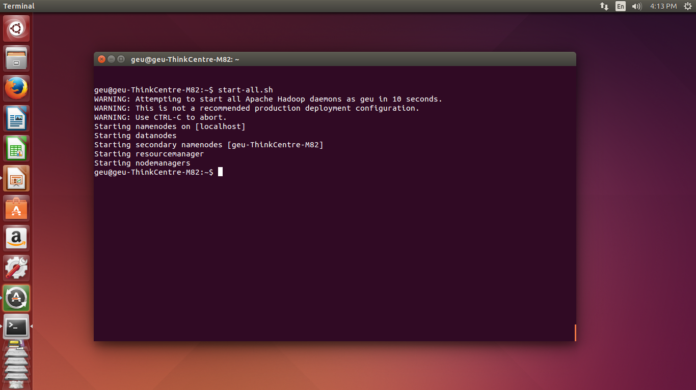

Slide 15
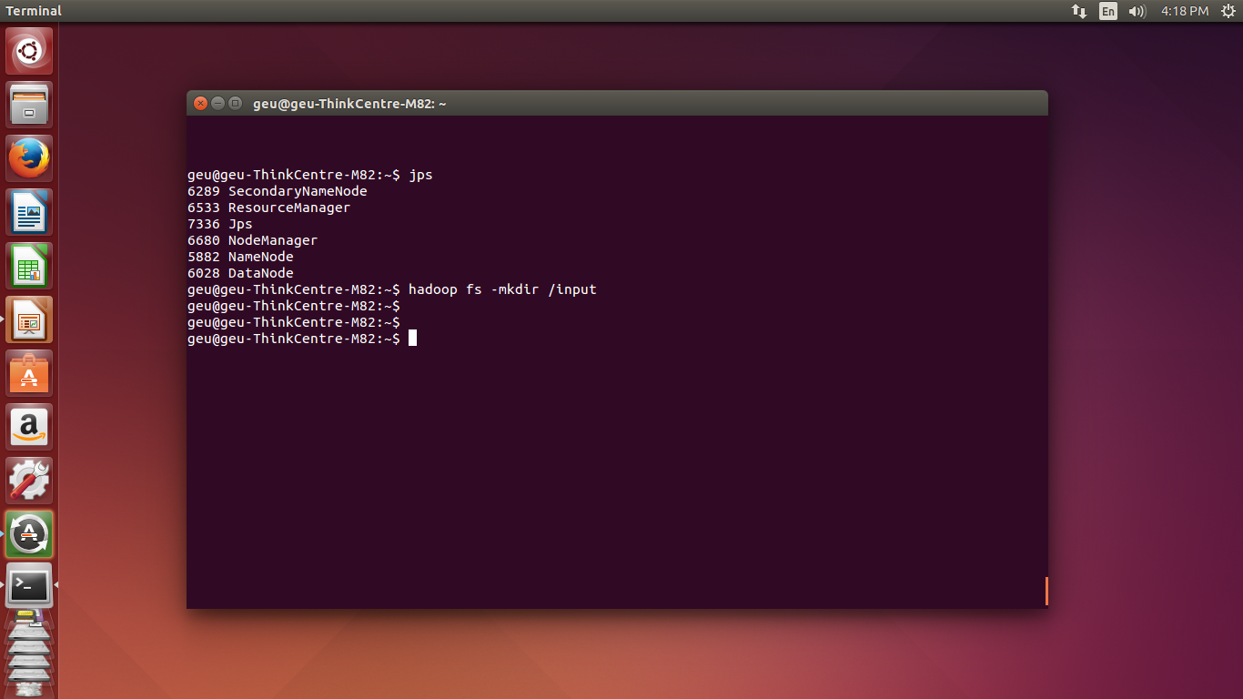

Slide 16
Contd…
Copy the input files into the distributed filesystem:
$ hadoop fs –put num.txt /input/
Verify num.txt available in HDFS input directory .
$ hadoop fs -ls /input/
Examine the contents of file:
$ hadoop fs -cat /input/num.txt

Slide 17
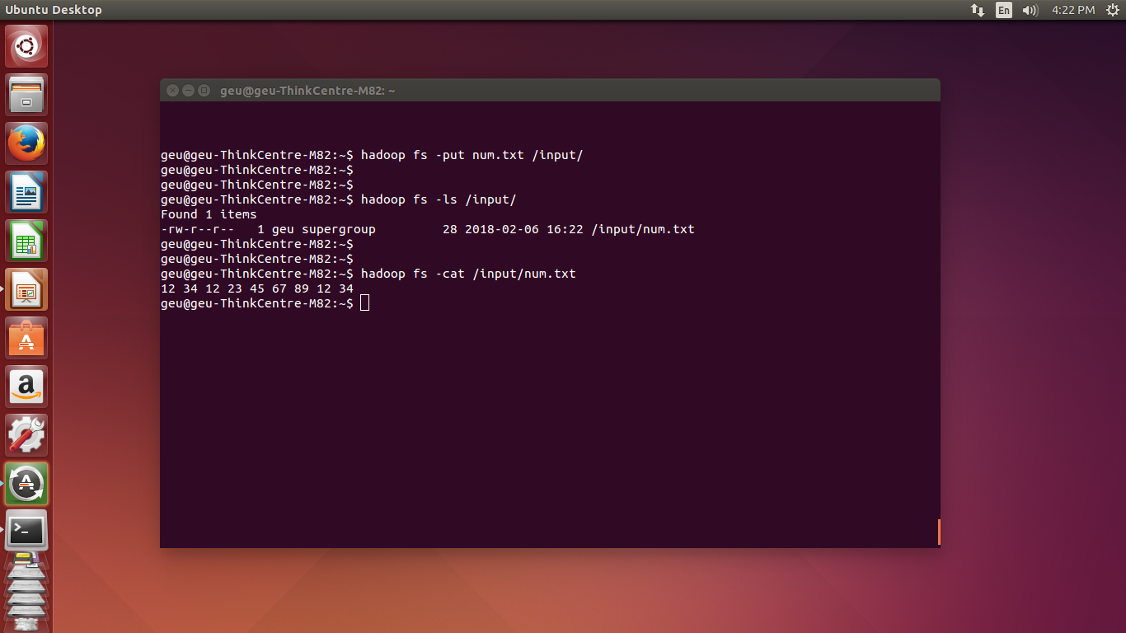

Slide 18
Contd…
Compile WordCount.java file which contain the code and create the jar file using
$ hadoop com.sun.tools.javac.Main WordCount.java
$ jar cf wc.jar WordCount*.class
Make sure you set the environment variables as :
export PATH=$PATH:$JAVA_HOME/bin
export HADOOP_CLASSPATH=$JAVA_HOME/lib/tools.jar
{hint:- .bashrc}

Slide 19
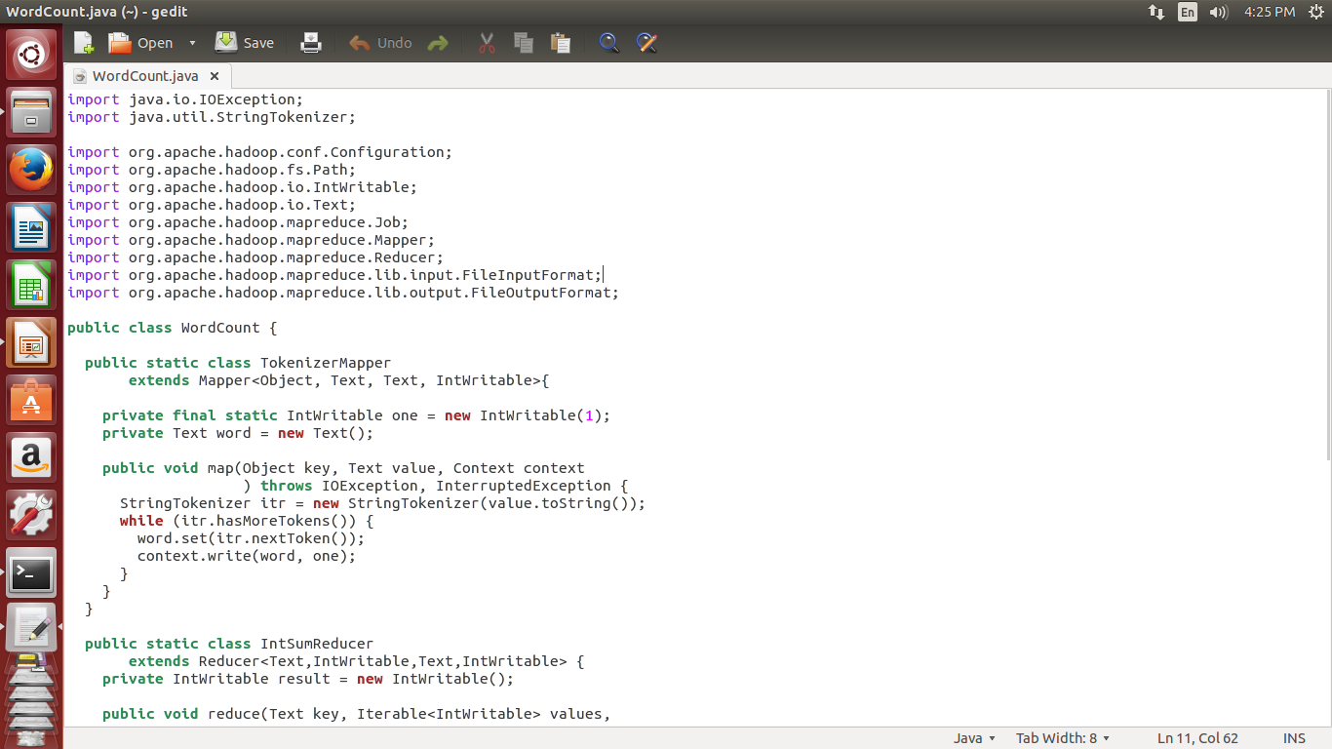
Source code:
https://hadoop.apache.org/docs/stable/hadoop-mapreduce-client/hadoop-mapreduce-client-core/MapReduceTutorial.html

Slide 20
Contd…
Run wc.jar and also provide input and out directories
$ hadoop jar wc.jar WordCount /input /output
Verify content for generated output file.
$ hadoop dfs -cat /output/*
Stop the daemon processes.

Slide 21
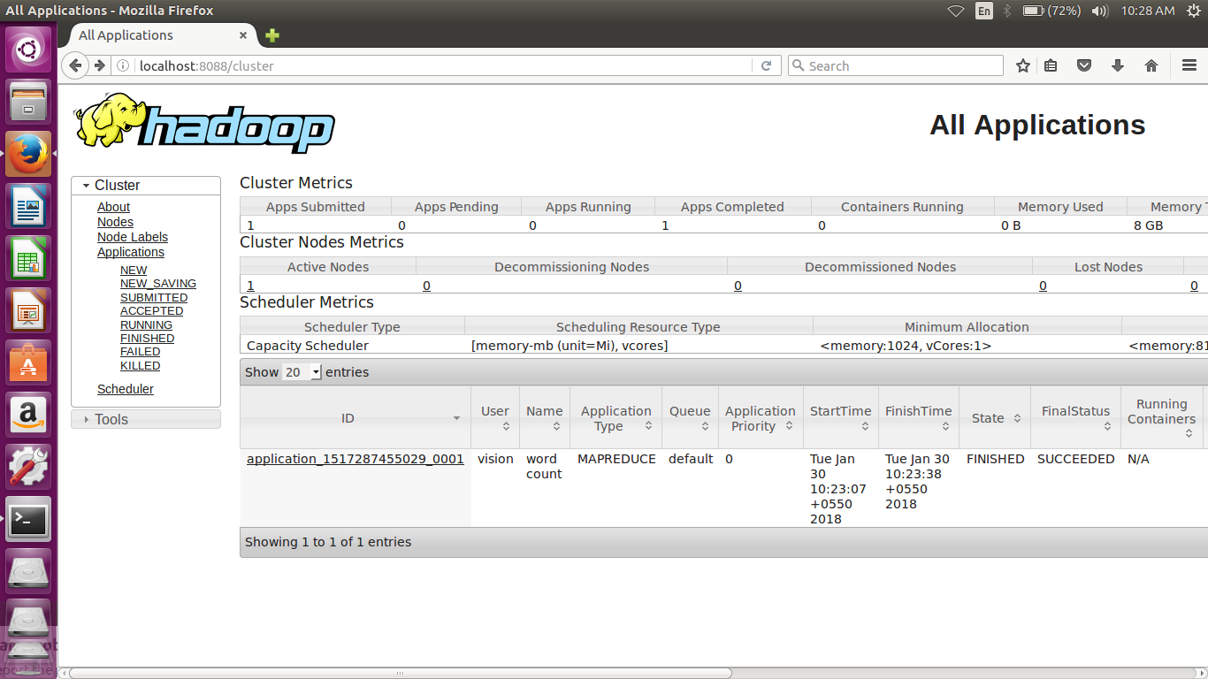
Localhost

Slide 22
Output

Slide 23
THANK YOU!!

